Slide 1
DIP 2013 – Smart Fast Forward

Slide 2
Overview

Slide 3
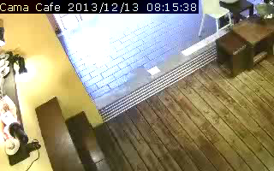
Smart Fast Forward Concept

Slide 4
Processing Stage Overview
Multi-Threaded!
OpenCV
Decoder
Background
Subtraction
Object Detection
Video
Object Regions & Labels
Object Labeling
(Tracking)
Frame weight
estimation
Kalman
Filter
Playback Speed

Slide 5
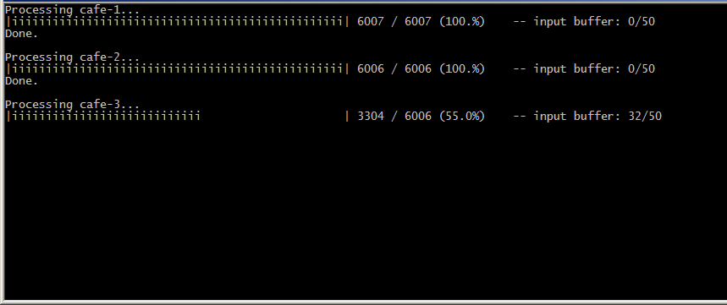
Processing Stage Output

Slide 6
Background Subtraction

Slide 7
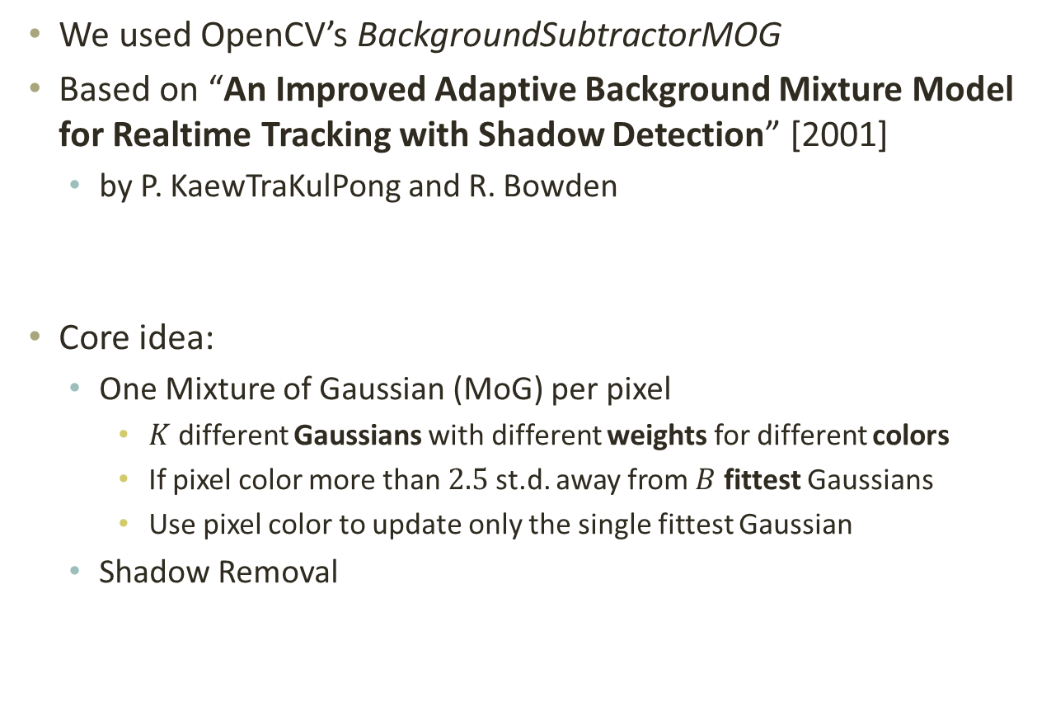
Background Subtraction MoG
We used OpenCV’s BackgroundSubtractorMOG
Based on “An Improved Adaptive Background Mixture Model for Realtime Tracking with Shadow Detection” [2001]
by P. KaewTraKulPong and R. Bowden
Core idea:
One Mixture of Gaussian (MoG) per pixel
$K$ different Gaussians with different weights for different colors
If pixel color more than $2.5$ st.d. away from $B$ fittest Gaussians
Use pixel color to update only the single fittest Gaussian
Shadow Removal

Slide 8
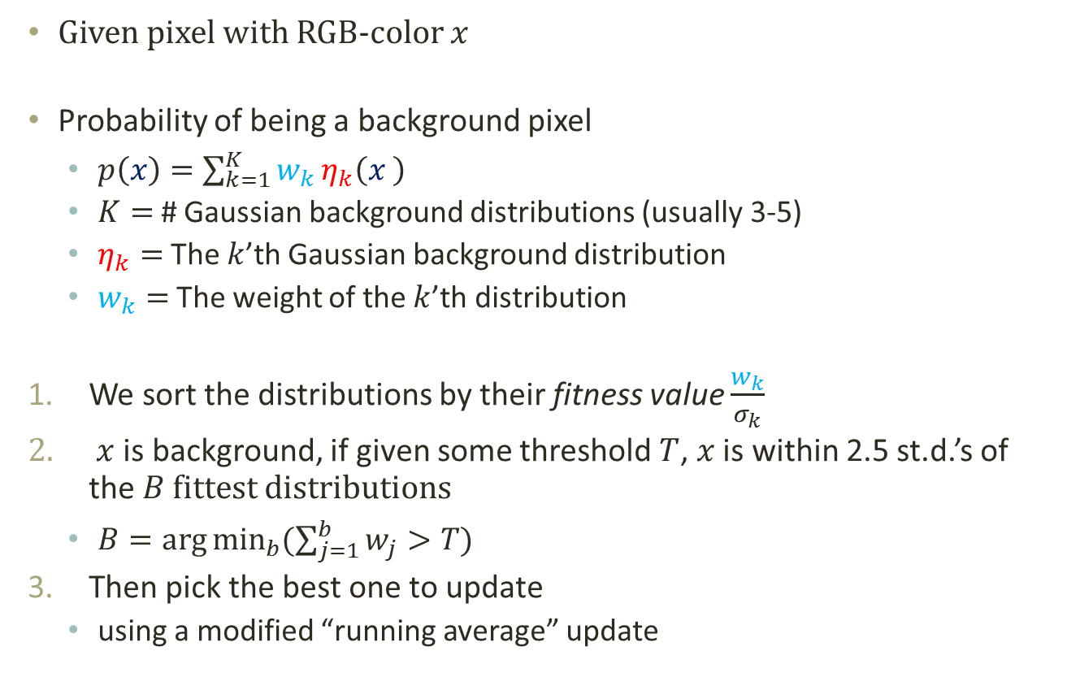
Background Subtraction MoG
Given pixel with RGB-color $x$
Probability of being a background pixel
$p\left(x\right)=\sum_{k=1}^{K}{w_{k}}η_{k}\left(x \right)$
$K=$ # Gaussian background distributions (usually 3-5)
$η_{k}=$ The $k$’th Gaussian background distribution
$w_{k}=$ The weight of the $k$’th distribution
We sort the distributions by their fitness value $\frac{w_{k}}{σ_{k}}$
$x$ is background, if given some threshold $T$, $x$ is within 2.5 st.d.’s of the $B$ fittest distributions
$B=\arg{\min_{b}{(\sum_{j=1}^{b}{w_{j}}>T)}}$
Then pick the best one to update
using a modified “running average” update

Slide 9
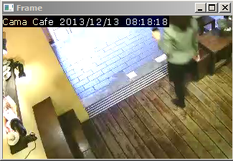
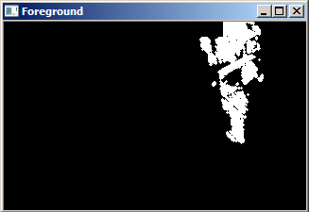
Background Subtraction Results

Slide 10
Object detection

Slide 11

Object Detection
Object detection includes the main phase to identify objects in a scene by means of clustering.
Simple techniques are used to perform preliminary denoising, and small cluster that is likely to be noise / false response (such as shadows) are also discarded.
Denoise
Clustering
Abandon small cluster
Notes:
在有了 foreground mask 之後，Objection detection phase 的目的是根據 foreground mask 辨識當前的場景有哪些 object，並決定各個 foreground pixel 是屬於哪個 object。

Slide 12
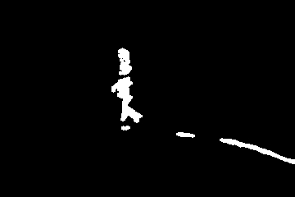
Object Detection Example instance
Notes:
可能遇到的問題： occlusion、disconnection、shadow

Slide 13
Object Detection Agglomerative Clustering
Clustering to identify individual objects.
But centroid-based clustering are prone to stretched clusters or varying cluster size.
Agglomerative (Hierarchical) Clustering: bottom-up, close clusters merged first.
One of the efficient implementations is similar to finding a planar Minimum-Spanning Tree.
Finals clusters are broken by “weakest” (farthest) link
Closest clusters are then merged into a larger one
Initially each pixel is an individual cluster
Notes:
Centroid-based clustering 像是 KNN 其實並不善於應付各種形狀的 cluster，
因此我們使用 bottom-up 的 agglomerative clustering 從小到大地把 cluster 連起來。
一開始每個 pixel 是一個最小單位的 cluster，之後每次將相鄰的 cluster 合併，直到沒有夠接近的 cluster 為止。

Slide 14
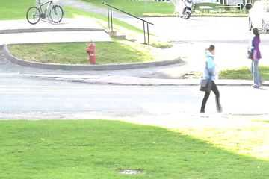
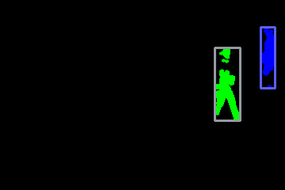
Object Detection Intermediate Result
Different clusters are identified as different objects

Slide 15
Object Tracking

Slide 16
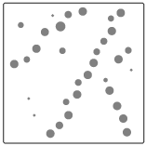
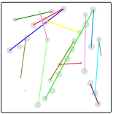
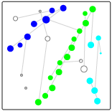
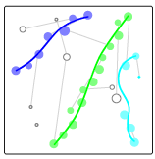
Object Tracking
Time
Space
Notes:
Object detection 讓我們找到各個單獨的 frame 中的物件，但是 inter-frame 的關係並不明確。
要知道一個東西在下一個 frame 移到哪裡，或是和其他東西重疊，我們使用 minimum-cost matching 來找到最好的情形。

Slide 17
Object Tracking Matching
Inter-frame relationships determined by weighted matching.
Here, the term “matching” is general and it is possible for multiple object to match into one (occlusion) or vice versa.
Matching cost between two clusters (of consecutive frame) is a value determined by their:
difference in feature (expected position, size)
penalty depending on situations (e.g. merging, abandoning)
Efficient algorithms (e.g. Hungarian Method) exist.
Match cost | obj_{a}@t | obj_{b}@t | obj_{c}@t
obj₁@t-1 | …
obj₂@t-1 | … | …
obj₃@t-1 | … | … | …
Notes:
Object detection 讓我們找到各個單獨的 frame 中的物件，但是 inter-frame 的關係並不明確。
要知道一個東西在下一個 frame 移到哪裡，或是和其他東西重疊，我們使用 minimum-cost matching 來找到最好的情形。

Slide 18
Object Tracking Matching Model
Frame @ t-1
Frame @ t
Links have cost associated with feature difference between clusters
Using a node multiple time (overlapping) has additional cost
A node that is not matched (discarded/new cluster) has cost proportional to cluster size
NIL
NIL
Notes:
前一個 frame detect 到的物件 和 當前 frame detect 的物件是 bipartite graph 兩邊的 node。
影響 Matching cost 的則是兩個 cluster 之間有多可能是相同的物件。
除此以外，overlapping 有可能導致多對一的情形的發生，一些小物件也有可能只是 noise cluster 例如影子，
因此 多對一(overlapping) 和 沒有matching(discarded) 的情形也會有附屬的 cost。

Slide 19
Playback Speed estimation

Slide 20
Playback Speed Estimation Frame Weights
Used to determine the “importance” of a frame, and thus affects the playback speed.
Frame weights are determined by the following factors:
Number of objects in frame
Matching cost -> scene variation
Foreground area size
Basic smoothing (running average)
Notes:
要達成 Smart playback，最重要的事情就是決定一個 frame 有多重要，
這通常取決於那個 frame 之中發生了多少事情和有多大的變化，
因此我們用 一個 frame 中有多少物件、foreground area 有多大，
以及 object tracking stage 的 matching cost – cost 越高一般代表物件的變化情形越劇烈 來 model 這件事情。

Slide 21
Playback Speed Estimation Playback Sequence
The higher the frame weight, the slower the playback speed.
Relation between frame weight and frame duration is linear. Specifically, given parameters MaxSpeedUp, TotalFrame, each frame weight is reweighted to: w_{new} = 1 + (w_{old}–w_{min})/(w_{max}–w_{min}) * (MaxSpeedUp-1) * TotalFrame
Time spent on a frame is proportional to the adjusted weight, so the playback sequence could easily be determined accordingly.
Notes:
有了初步的 frame weight 之後，可以經過簡單的 smoothing 和 linear 調整給每個 frame 他應該撥放的 duration，
並依此得到 smart playback 每個 frame 應該播放的是什麼。

Slide 22
Results
TODO

